Slide 1





INTENSITY ANALYSIS:
Method to measure change among land categories through time
Robert Gilmore Pontius Jr
Clark University, USA
rpontius@clarku.edu
www.clarku.edu/~rpontius

Slide 2
Internet Links
Participants should watch this video http://v.youku.com/v_show/id_XNzA4NTc5NjEy.html
Participants should read this manuscript http://www.mdpi.com/2073-445X/2/3/351
Participants should see the zip file of PDFs of journal articles that is item number 61 on http://www.clarku.edu/~rpontius/
Participants should get the Excel that is item number 4 in red on http://www.clarku.edu/~rpontius/

Slide 3
Intensity Analysis …
considers maps at T time points for the same set of J categories.
reads a contingency table for each time interval.
computes changes at three levels: interval, category, and transition.
tests stationarity of changes across time intervals
has more than 200 citations of the first paper.

Slide 4
Plum Island Ecosystems (PIE) in USA
Professor Bin Quan has this same data format for Changsha.

Slide 5
Each time interval has a contingency table.
C_{tij} is the number of pixels that transition from category i at time t to category j at time t+1.
Professor Bin Quan has this same data format for Changsha.

Slide 6
Purpose
Intensity Analysis reveals information from the set of T-1 contingency tables to compare observed changes versus hypothetical uniform changes.
Intensity Analysis shows three levels of information concerning whether each:
  time interval is fast versus slow
  category is active versus dormant in terms of gross loss and gross gain
  transition is targeting versus avoiding other categories

Slide 7
Questions Answered
Interval level shows whether the amount of change is large simply because the duration of the interval is long.
Category level shows whether the loss or gain of a category is large simply because the category is large.
Transition level shows whether the transition is large simply because the sizes of the transitioning categories are large.

Slide 8
Three levels of Intensity Analysis
Interval level compares the annual change across time intervals.
Category level measures for each time interval: the size of each category’s loss relative to the size of the category at the interval’s initial time point, and the size of each category’s gain relative to the size of the category at the interval’s end time point.
Transition level measures for each transition in each time interval: the size of the transition’s gain relative to the size of the categories at the initial time point, and the size of the transition’s loss relative to the size of the categories at the end time point.

Slide 9
Criticism or Compliment?
One of the reviewers of Aldwaik and Pontius (2012) summarizes perfectly the most common reaction readers have to this method by writing “the analysis is so straightforward . . . any reasonable thinking scientist would come up with a similar approach to analysis and it should be obvious to most anyone that these analyses should be done. I would hope that to be the case. The proposed approach is just good, basic common sense bookkeeping of how to describe change.”

Slide 10
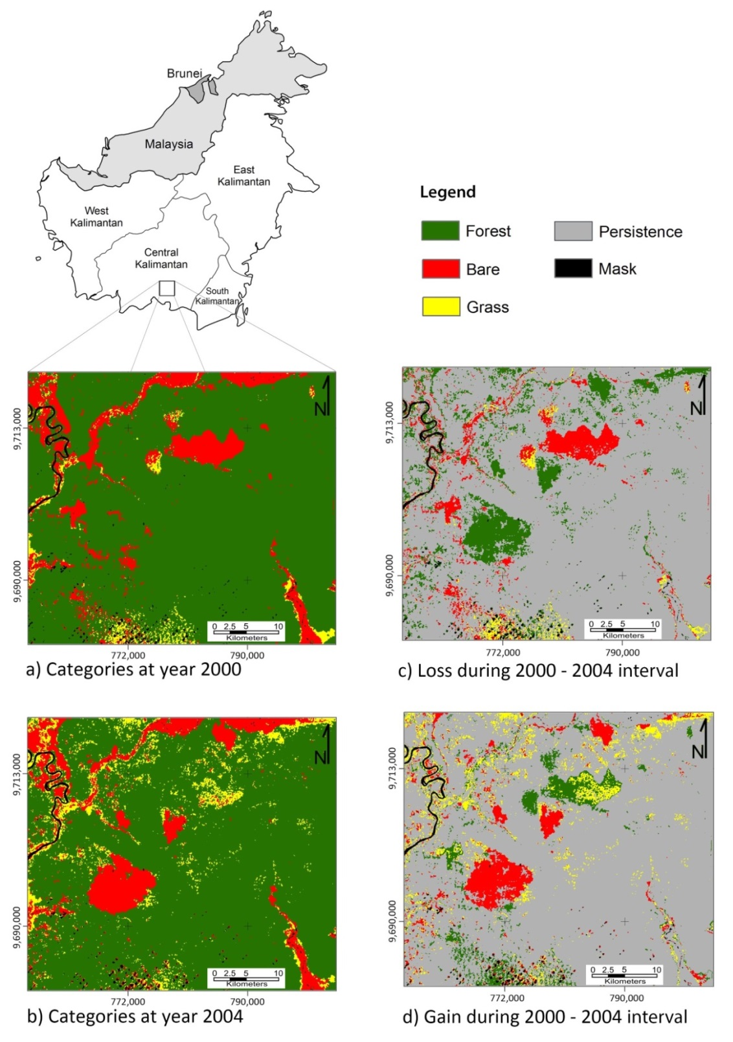
The location of the study site is the southern part of the island of Borneo, which is shared by Indonesia, Malaysia and Burnei. Kalimantan is the Indonesian portion of Borneo. The study site is in Central Kalimantan Province.
Black means mask.

Slide 11
Maps on the left show land-cover categories at 2000 and 2004.
There are only three categories. How complicated can it be?

Slide 12
Maps on the left show land-cover categories at 2000 and 2004.
Maps on the right show changes during 2000–2004.

Slide 13
Category level information
Red indicates persistence
 |  | 2004 |  |  | 2000 | Interval
 |  | Forest | Bare | Grass | Total | Loss
2000 | Forest | 76.8 |  |  | 86.5 | 9.7
 | Bare |  | 5.5 |  | 11.2 | 5.7
 | Grass |  |  | 0.9 | 2.4 | 1.5
2004 | Total | 81.9 | 11.4 | 6.7 | 100.0
Interval | Gain | 5.1 | 6.0 | 5.8 |  | 16.9

Slide 14
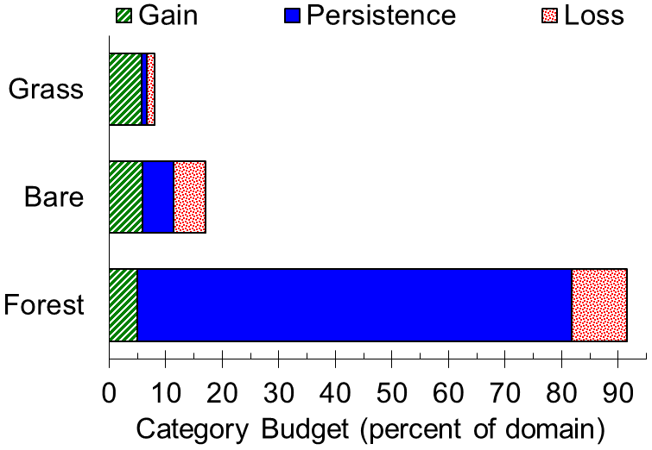
Gross gain, persistence and gross loss by category during 2000-2004

Slide 15
Notation for Pontius, Gao, et al. (2013)
Symbol | Meaning
J | number of categories, which equals 3 in our case study
i | index for a category at the interval’s initial time point
j | index for a category at the interval’s final time point
C_{ij} | number of pixels that transition from category i to category j
S | total change as percent of domain

Slide 16
Notation for central entries
 |  | 2004 |  |  | 2000 | Interval
 |  | Forest | Bare | Grass | Total | Loss
2000 | Forest | C₁₁ | C₁₂ | C₁₃
 | Bare | C₂₁ | C₂₂ | C₂₃
 | Grass | C₃₁ | C₃₂ | C₃₃
2004 | Total
Interval | Gain

Slide 17
Equations 1-3
Total change is sum of all central entries minus sum of diagonal entries.
Quantity change is sum of net gain for all net gaining categories.
Allocation change is Total Change minus Quantity change.

Slide 18
Equations 1-3

Slide 19
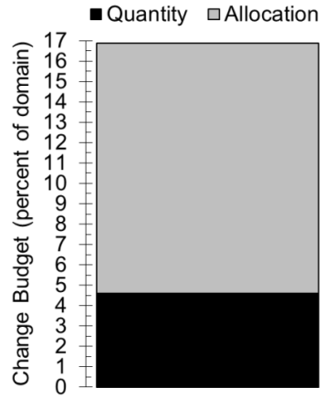
Total change separated into quantity disagreement and allocation disagreement

Slide 20
Which of these two comparison maps is more different from the reference map?
G
G
G
G
G
G
G
G
G
G
G
G
R
R
R
R
G
G
R
G
R
R
R
R
Comparison 1
R
R
R
R
R
R
R
R
R
R
R
G
R
R
R
R
Reference
R
R
R
R
R
R
G
R
Comparison 2

Slide 21
Comparison 1 is more different according to proportion disagreement.
G
G
G
G
Proportion Disagreement = 14/16
G
G
G
G
G
G
G
G
R
R
R
R
G
G
R
G
R
R
R
R
Comparison 1
R
R
R
R
R
R
R
R
Proportion Disagreement = 2/16
R
R
R
G
R
R
R
R
Reference
R
R
R
R
R
R
G
R
Comparison 2

Slide 22
Quantity and Allocation are two reasons for disagreement, which we separate.
G
G
G
G
Proportion Disagreement = 14/16
G
G
G
G
Quantity Disagreement is 14/16. Allocation disagreement is 0/16.
G
G
G
G
R
R
R
R
G
G
R
G
R
R
R
R
Comparison 1
R
R
R
R
R
R
R
R
Proportion Disagreement = 2/16
R
R
R
G
R
R
R
R
Reference
Allocation Disagreement is 2/16. Quantity disagreement is 0/16.
R
R
R
R
R
R
G
R
Comparison 2

Slide 23
Questions for category level losses
What are order of the categories in terms of size at 2000?
If you saw only the map of 2000, then which categories would you expect to be involved in the largest losses?
What are order of the categories in terms of gross losses during 2000-2004?
If change were uniform across the domain, then what intensity of loss would each category experience?
Which categories experience loss more intensively than uniform change?
Which categories experience loss less intensively than uniform change?

Slide 24
Category level information
Size at each time point
 |  | 2004 |  |  | 2000 | Interval
 |  | Forest | Bare | Grass | Total | Loss
2000 | Forest |  |  |  | 86.5
 | Bare |  |  |  | 11.2
 | Grass |  |  |  | 2.4
2004 | Total | 81.9 | 11.4 | 6.7 | 100.0
Interval | Gain |  |  |  |  | 16.9

Slide 25
Category level information
Red indicates persistence
 |  | 2004 |  |  | 2000 | Interval
 |  | Forest | Bare | Grass | Total | Loss
2000 | Forest | 76.8 |  |  | 86.5 | 9.7
 | Bare |  | 5.5 |  | 11.2 | 5.7
 | Grass |  |  | 0.9 | 2.4 | 1.5
2004 | Total | 81.9 | 11.4 | 6.7 | 100.0
Interval | Gain | 5.1 | 6.0 | 5.8 |  | 16.9

Slide 26
There will be 17% change in this landscape.

Slide 27
Questions for category level gains
What are order of the categories in terms of size at 2004?
If you saw only the map of 2004, then which categories would you expect to be involved in the largest gains?
What are order of the categories in terms of gross gains during 2000-2004?
If change were uniform across the domain, then what intensity of gain would each category experience?
Which categories experience gain more intensively than uniform change?
Which categories experience gain less intensively than uniform change?

Slide 28
There was 17% change in this landscape.

Slide 29
Maps on the left show land-cover categories at 2000 and 2004.
Maps on the right show changes during 2000–2004.

Slide 30
If i denotes a category at time 1 and j denotes a category at time 2, then write equations that give the intensity with which each category experiences change relative to its size for:
Intensity of gain
Intensity of loss

Slide 31
Equations 4-5 for comparison to uniform

Slide 32
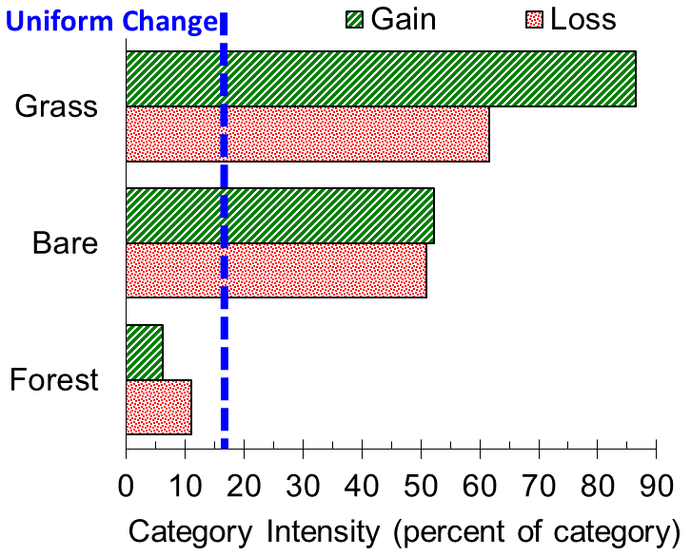
Intensities of category-level gross losses and gross gains compared to uniform gross change
dormant
active

Slide 33
Transition level changes with Forest
Is Forest more likely to gain from Bare or Grass according to your intuition?
Is Forest more likely to gain from Bare or Grass according to the table?
If Forest were to gain uniformly across the landscape of 2000, then how much would Forest take from Bare and Grass of 2000?
The transition from Bare to Forest is larger than the transition from Grass to Forest, but Intensity Analysis in the next slide concludes that the gain of Forest avoids Bare and targets Forest. Can you explain this?
Is Forest more likely lose to Bare or Grass according to your intuition?
Is Forest more likely to lose to Bare or Grass according to the table?
If Forest were to lose uniformly across the landscape of 2004, then how much would Forest take from Bare and Grass of 2004?
The transition from Forest to Bare is larger than the transition from Forest to Grass, but Intensity Analysis in the next slide concludes that the Bare avoids Forest’s loss and Grass targets Forest’s loss. Can you explain this?
Pontius presented to you Intensity Analysis’ logic to gains, and then used the same logic to analyze losses. Do you see any problem with this?
Does the loss of a category during 200-2004 influence the size of the category at 2000?
Does the gain of a category during 200-2004 influence the size of the category at 2004?

Slide 34
Forest is going to gain on 5% of this landscape.
What will be the size of the transition from Bare to Forest?
What will be the size of the transition from Grass to Forest?

Slide 35
Category level information
Red indicates persistence
 |  | 2004 |  |  | 2000 | Interval
 |  | Forest | Bare | Grass | Total | Loss
2000 | Forest | 76.8 |  |  | 86.5 | 9.7
 | Bare |  | 5.5 |  | 11.2 | 5.7
 | Grass |  |  | 0.9 | 2.4 | 1.5
2004 | Total | 81.9 | 11.4 | 6.7 | 100.0
Interval | Gain | 5.1 | 6.0 | 5.8 |  | 16.9

Slide 36
Transitions as a percent of the domain.
Superscript α indicates a systematically avoiding transition.
Superscript τ indicates a systematically targeting transition.
 |  | 2004 |  |  | 2000 | Interval
 |  | Forest | Bare | Grass | Total | Loss
2000 | Forest | 76.8 | 5.7^{α} | 4.0 | 86.5 | 9.7
 | Bare | 4.0^{α} | 5.5 | 1.8^{τ} | 11.2 | 5.7
 | Grass | 1.1 | 0.3^{τ} | 0.9 | 2.4 | 1.5
2004 | Total | 81.9 | 11.4 | 6.7 | 100.0
Interval | Gain | 5.1 | 6.0 | 5.8 |  | 16.9

Slide 37
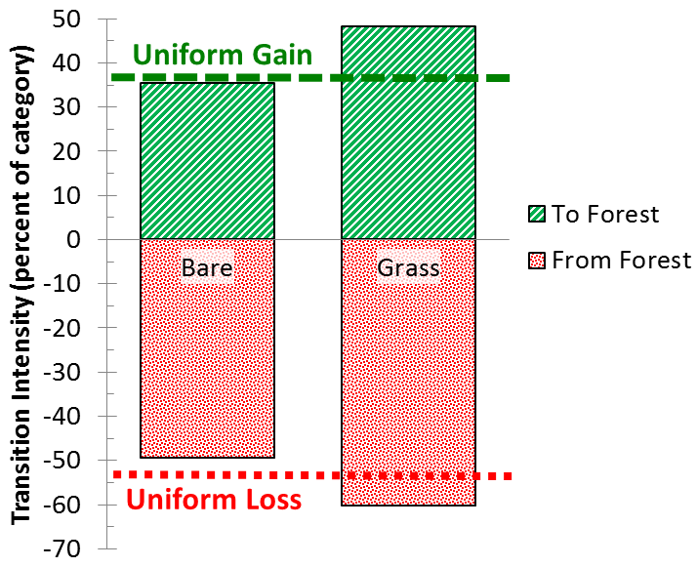
Intensity of transitions given Forest’s gain on the positive axis and given Forest’s loss on the negative axis

Slide 38
Forest recently lost on 10% of this landscape.
What was the size of the transition from Forest to Bare?
What will be the size of the transition from Forest to Grass?

Slide 39
Equations 6-7 examine transitions to category n

Slide 40
Equations 8-9 examine transitions from category m

Slide 41
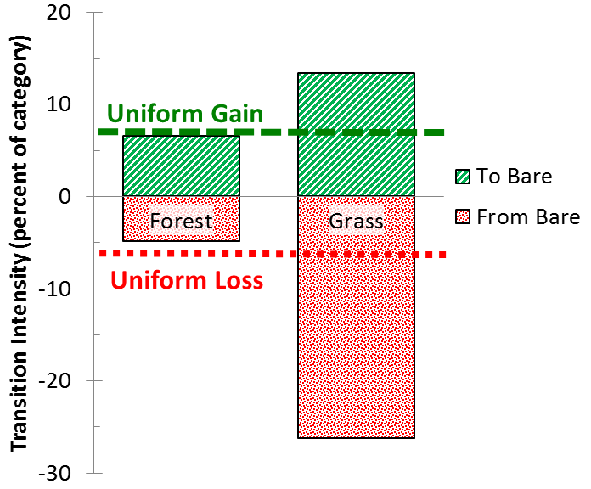
Intensity of transitions given Bare’s gain on the positive axis and given Bare’s loss on the negative axis

Slide 42
Transitions as a percent of the domain.
Superscript α indicates a systematically avoiding transition.
Superscript τ indicates a systematically targeting transition.
 |  | 2004 |  |  | 2000 | Interval
 |  | Forest | Bare | Grass | Total | Loss
2000 | Forest | 76.8 | 5.7^{α} | 4.0 | 86.5 | 9.7
 | Bare | 4.0^{α} | 5.5 | 1.8^{τ} | 11.2 | 5.7
 | Grass | 1.1 | 0.3^{τ} | 0.9 | 2.4 | 1.5
2004 | Total | 81.9 | 11.4 | 6.7 | 100.0
Interval | Gain | 5.1 | 6.0 | 5.8 |  | 16.9

Slide 43
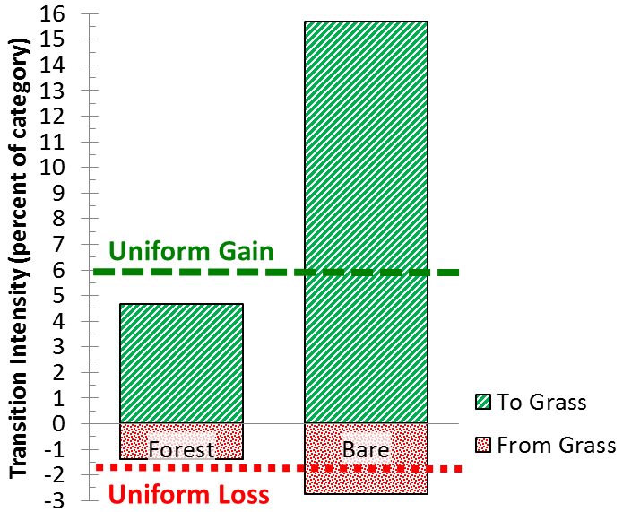
Intensity of transitions given Grass’ gain on the positive axis and given Grass’ loss on the negative axis

Slide 44
Definition of Systematic
(Pontius et al. 2004 is different from Alo and Pontius 2008)
The transition from category m to category n is a systematically targeting transition when the gain of n targets m while n targets the loss of m, i.e., when R_{mn} > W_{n} while Q_{mn} > V_{m}.
The transition from category m to category n is a systematically avoiding transition when the gain of n avoids m while n avoids the loss of m, i.e., when R_{mn} < W_{n} while Q_{mn} < V_{m}.

Slide 45
Why is the transition from …
Bare to Forest systematically avoiding?
Grass to Forest not systematic?
Bare to Grass systematically targeting?

Slide 46
If a table shows time going forward, then should Intensity Analysis consider …
losses but not gains at the category-level
  because category-level losses are conditional on the initial time but category-level gains are conditional on the final time.
gains but not losses at transition-level
  because transition-level gains are conditional on the initial time but transition-level losses are conditional on the final time.

Slide 47
PontiusMatrix40.xlsx
Obtain this Excel file for free from www.clarku.edu/~rpontius

Slide 48
Effect of various amount of persistence on intensities.
Red numbers are the only ones that vary. All tables are symmetric.
 |  | 2004 |  |  | 2000 | Interval
 |  | Forest | Bare | Grass | Total | Loss
2000 | Forest | 1 | 2 | 1 | 4 | 3
 | Bare | 2 | 1 | 0 | 3 | 2
 | Grass | 1 | 0 | 2 | 3 | 1
2004 | Total | 4 | 3 | 3 | 10
Interval | Gain | 3 | 2 | 1 |  | 6
Table that shows Forest’s gain targets Bare and Bare targets Forest’s loss.
 |  | 2004 |  |  | 2000 | Interval
 |  | Forest | Bare | Grass | Total | Loss
2000 | Forest | 1 | 2 | 1 | 4 | 3
 | Bare | 2 | 2 | 0 | 4 | 2
 | Grass | 1 | 0 | 1 | 2 | 1
2004 | Total | 4 | 4 | 2 | 10
Interval | Gain | 3 | 2 | 1 |  | 6
Table that shows uniform transition intensities to Forest and from Forest for active Forest.
 |  | 2004 |  |  | 2000 | Interval
 |  | Forest | Bare | Grass | Total | Loss
2000 | Forest | 1 | 2 | 1 | 4 | 3
 | Bare | 2 | 3 | 0 | 5 | 2
 | Grass | 1 | 0 | 0 | 1 | 1
2004 | Total | 4 | 5 | 1 | 10
Interval | Gain | 3 | 2 | 1 |  | 6
Table that shows Forest’s gain avoids Bare and Bare avoids Forest’s loss.
 |  | 2004 |  |  | 2000 | Interval
 |  | Forest | Bare | Grass | Total | Loss
2000 | Forest | 4 | 2 | 1 | 7 | 3
 | Bare | 2 | 0 | 0 | 2 | 2
 | Grass | 1 | 0 | 0 | 1 | 1
2004 | Total | 7 | 2 | 1 | 10
Interval | Gain | 3 | 2 | 1 |  | 6
Table that shows uniform transition intensities to Forest and from Forest for dormant Forest.

Slide 49
Sensitivity to Persistence
Table 3 shows that the size of Bare equals the size of Grass at both time points. Intensity Analysis computes transition intensities, given the sizes of the categories at the time points. The transition from Bare to Forest is larger than the transition from Grass to Forest, thus Intensity Analysis indicates that the gain of Forest targets Bare and avoids Grass. The transition from Forest to Bare is larger than the transition from Forest to Grass, thus Intensity Analysis indicates that Bare targets the loss of Forest and Grass avoids the loss of Forest. For Tables 3–5, 3/4 of the final Forest derives from Forest’s gain and 3/4 of the initial Forest loses. Thus, Forest is active in both gains and losses for Tables 3–5, because 3/4 is greater than 6/10.
Table 4 shows that the size of Bare is twice the size of Grass at both time points. The transition from Bare to Forest is twice the transition from Grass to Forest, and the transition from Forest to Bare is twice the transition from Forest to Grass. Thus, Intensity Analysis indicates the intensities are uniform for both transitions from Forest and for both transitions to Forest.
Table 5 shows that the size of Bare is five times the size of Grass at both time points. The transition from Bare to Forest is less than five times the transition from Grass to Forest, thus the gain of Forest avoids Bare and targets Grass. The transition from Forest to Bare is less than five times the transition from Forest to Grass, thus Bare avoids the loss of Forest and Grass targets the loss of Forest.
Table 6 shows that the size of Bare is twice the size of Grass at both time points. The transition from Bare to Forest is twice the transition from Grass to Forest, and the transition from Forest to Bare is twice the transition from Forest to Grass. Thus, Intensity Analysis indicates that the intensities are uniform for both transitions from Forest and for both transitions to Forest, as in Table 4. In contrast to Table 4, Table 6 indicates that 3/7 of the final Forest derives from gain and 3/7 of the initial Forest loses. Thus, Forest is dormant in both gains and losses, because 3/7 is less than 6/10.

Slide 50
Two types of the
Large Dormant Category Problem
One type is a category that is involved in little change. Water is a typical category of this type.
Another type is a category that is involved in much change. Forest is a typical category of this type.

Slide 51
Plum Island Ecosystems (PIE) in USA

Slide 52
Logic of Algorithm
Interval Level
Category Level
Transition Level

Slide 53
Purpose of Method
We will never know the error in the data.
We can compute hypothetical error that could explain the patterns in the data.
We can compare the computed hypothetical error to the suspected error to tell whether a change is meaningfully different than uniform.

Slide 54
Time Interval Level
Interval 1971-1985 appears slow, but perhaps the maps have errors that omit change in red.
Intervals 1985-1991 and 1991-1999 appear fast, but perhaps the maps have errors that commit to more than the true amount of change in gray.

Slide 55
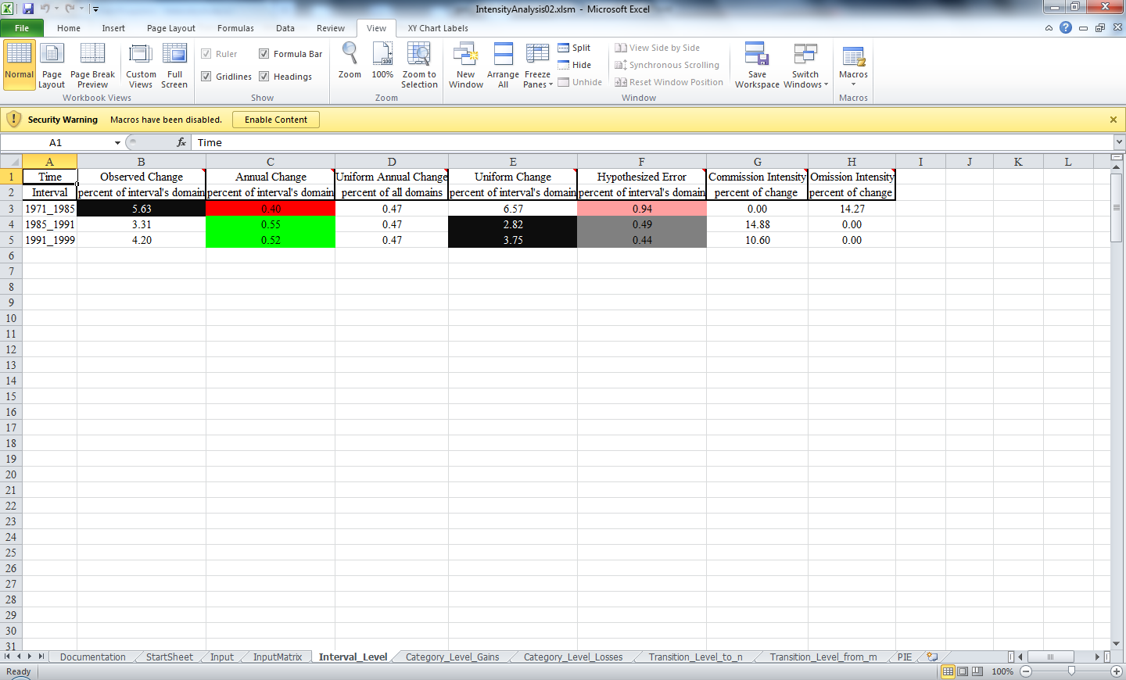
See the results in output

Slide 56
1991-1999 Category Level: Gain
Interpretation occurs here … .

Slide 57
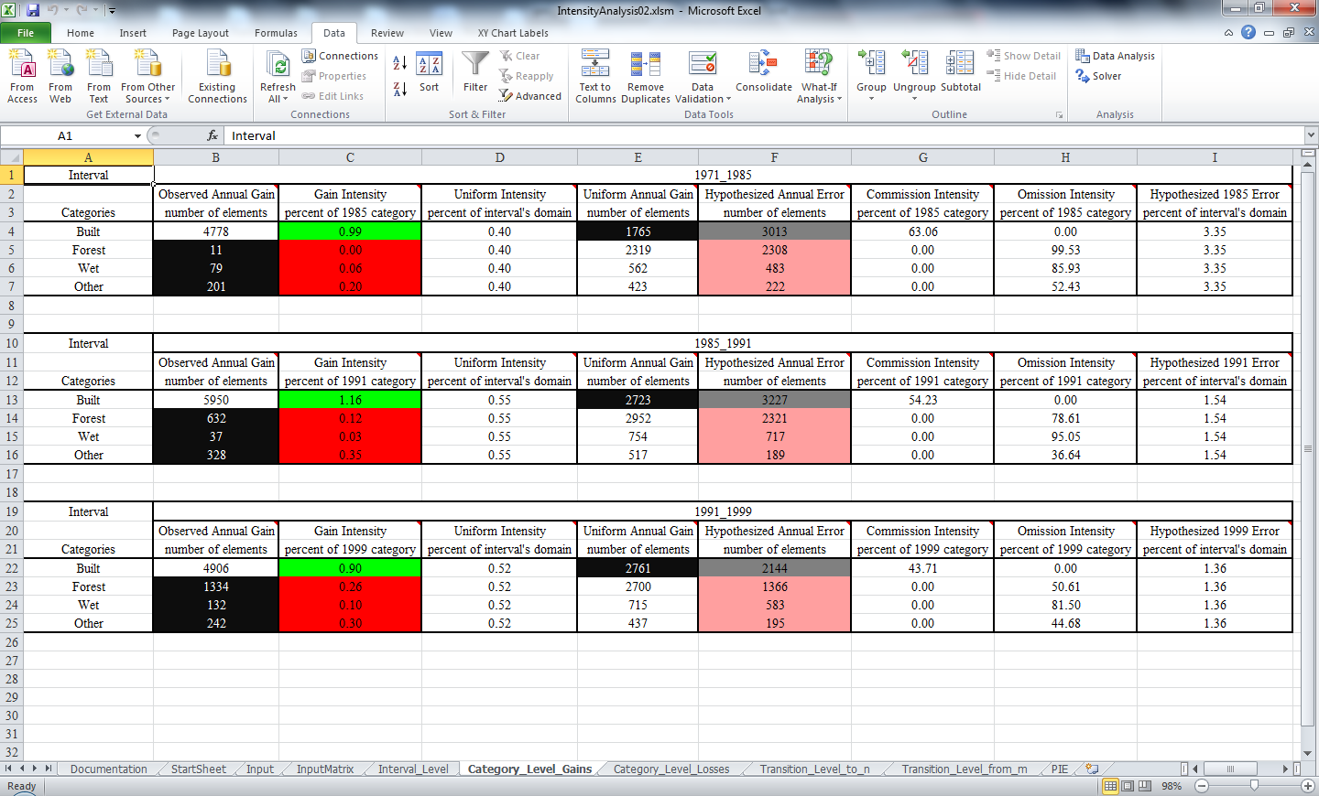
See the results in output

Slide 58
1991-1999 Category Level: Loss
Built appears to be a dormant loser, but maybe this is because error of omission of Built at 1991 in red.
Forest appears to be an active loser, but maybe this is because error of commission of forest at 1991 in gray.

Slide 59
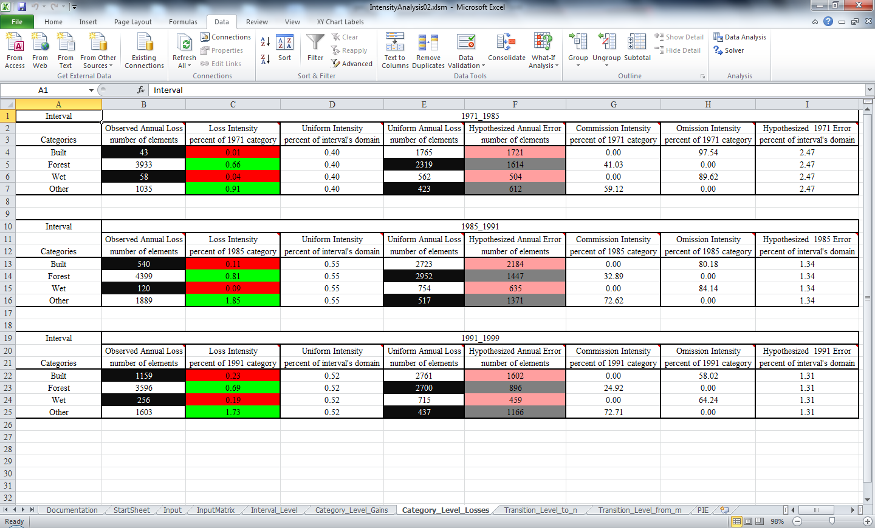
See the results in output

Slide 60
1991-1999 Transition Level: To Built
Built appears to avoid Forest, but maybe this is due to small Omission of Forest at 1991.
Built appears to avoid Wet, but maybe this is due to large Omission of Wet at 1991.
Built appears to avoid Other, but maybe this is due to Commission of Other at 1991.

Slide 61
1991-1999 Transition Level: To Built
Are Builders really avoiding Forest?
The intensity of the transition from Forest to Built is less than but close to the uniform intensity. Our method shows that 35 pixels of omission of Forest at 1991 can account for the deviation from uniform. The study area contains more than one million pixels.

Slide 62
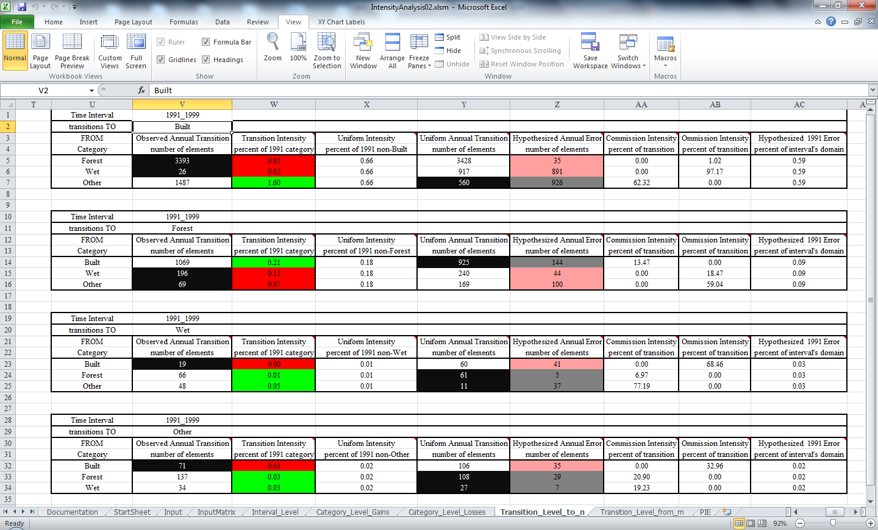
See the results in output

Slide 63
1991-1999 Transition Level: From Forest
Interpretation occurs here … .

Slide 64
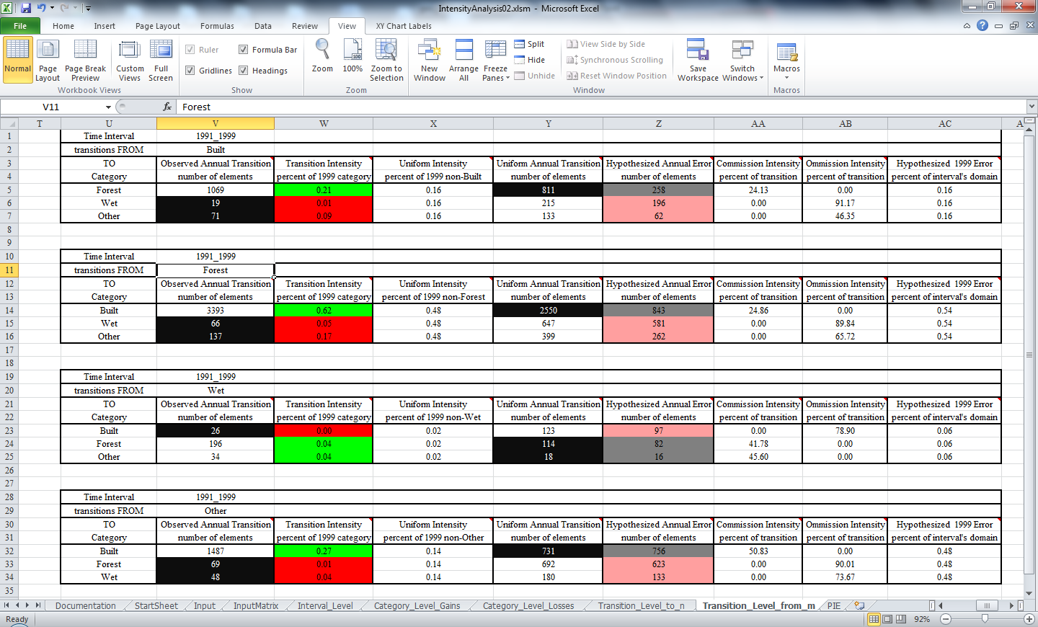
See the results in output

Slide 65
Hypothetical error intensities within the change region that could account for deviations from uniform category level losses and gains.
If the actual error intensities are less than the ones in the figure, then there is evidence that the category level gains and losses are non-uniform.

Slide 66
Net Quantity versus Swap Allocation
Quantity disagreement is the amount of difference between the reference map and a comparison map that is due to the less than perfect match in the proportions of the categories. This is also known as Net disagreement.
Allocation disagreement as the amount of difference between the reference map and a comparison map that is due to the less than optimal match in the spatial allocation of the categories, given the proportions of the categories in the reference and comparison maps. This is also known as Swap disagreement.

Slide 67
Reference versus Comparison
Y
Y
Y
Y
Y
R
Y
Y
Y
Y
Y
Y
G
G
R
G
Y
Y

Slide 68
Reference versus Comparison for one category
What is the total disagreement?
What is the quantity disagreement?
What is the allocation disagreement?

Slide 69
Reference versus Comparison for entire map
What is the total disagreement?
What is the quantity disagreement?
What is the allocation disagreement?

Slide 70
Reference versus Comparison
What is the total disagreement?
What is the quantity disagreement for red?
What is the quantity disagreement for green?
TRUE or FALSE: When the only colors are red and green, if the Reference map has more red than the Comparison map, then the Comparison map must have more green than the Reference map?
TRUE or FALSE: When there are more than two colors, if the Reference map has more of a particular color than the Comparison map, then the Comparison map must have more of some other color than the Reference map?

Slide 71
Get literature at www.clarku.edu/~rpontius
Aldwaik, Safaa and Robert Gilmore Pontius Jr. 2013. Map errors that could account for deviations from a uniform intensity of land change. International Journal of Geographical Information Science 27(9): 1717-1739.
Aldwaik, Safaa and Robert Gilmore Pontius Jr. 2012. Intensity analysis to unify measurements of size and stationarity of land changes by interval, category, and transition. Landscape and Urban Planning 106: 103-114.
Pontius Jr, Robert Gilmore, Emily Shusas and Menzie McEachern. 2004. Detecting important categorical land changes while accounting for persistence. Agriculture, Ecosystems & Environment 101(2-3): 251-268.

Slide 72
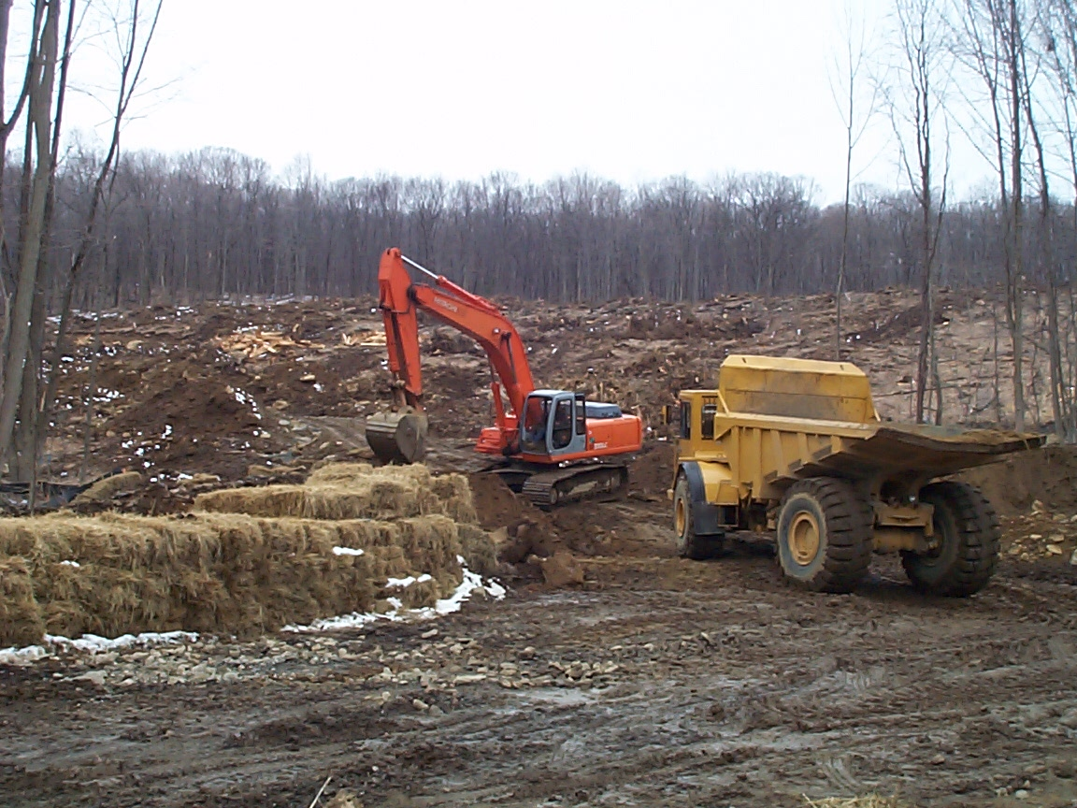
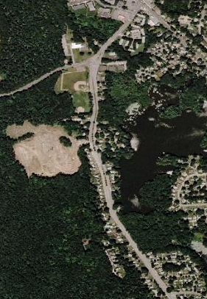
From Forest To Residential 2003

Slide 73
Worcester Massachusetts and nine surrounding towns
Pontius Jr, Robert Gilmore and Jeffrey Malanson. 2005. Comparison of the structure and accuracy of two land change models. International Journal of Geographical Information Science 19(2): 243-265.

Slide 74
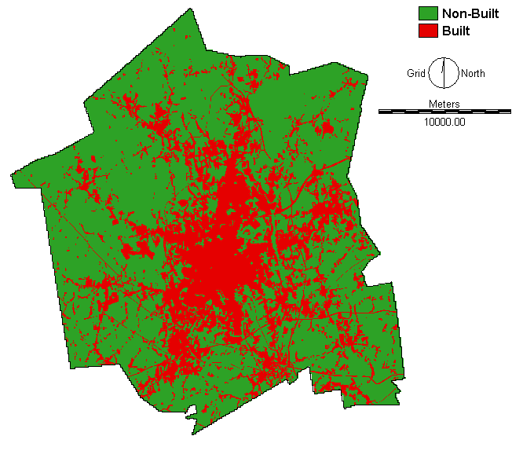
Built 1971

Slide 75

Built 1985

Slide 76
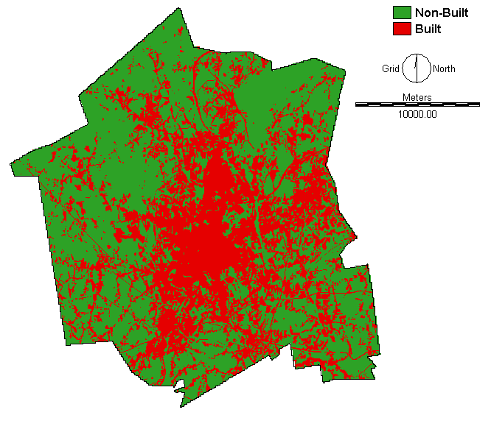
Built 1999

Slide 77
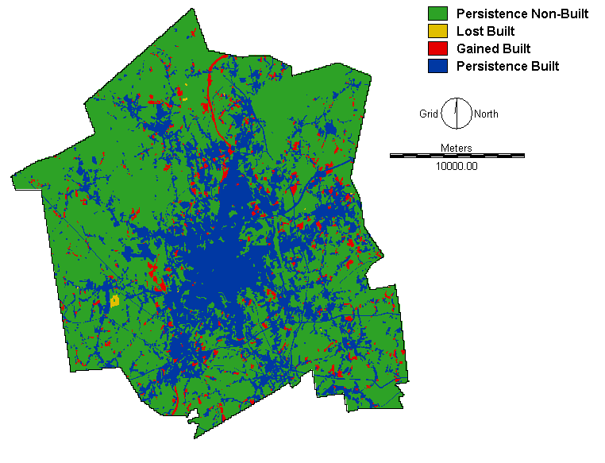
Signal to Calibrate 1971-1985

Slide 78

Pattern to Predict 1985-1999

Slide 79

Paint analogy for quantity and allocation

Slide 80
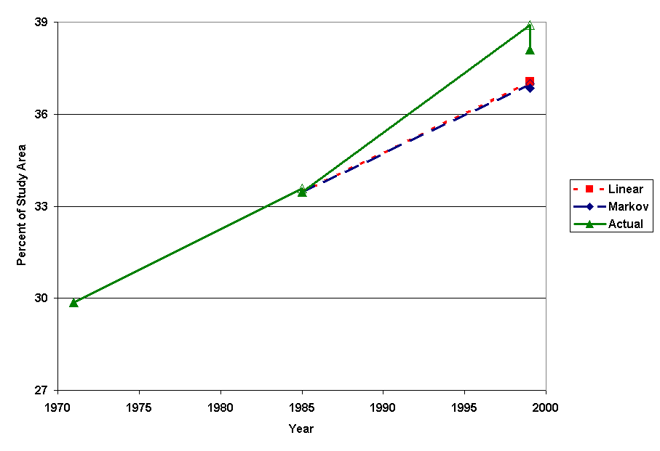
Quantity of Built
Validation
Extrapolation
Calibration

Slide 81
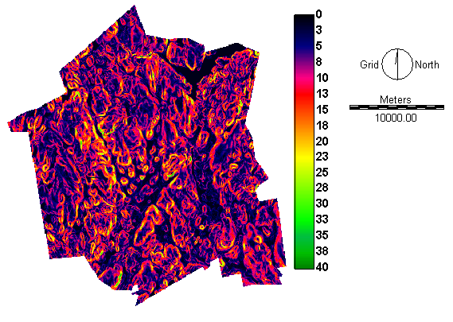
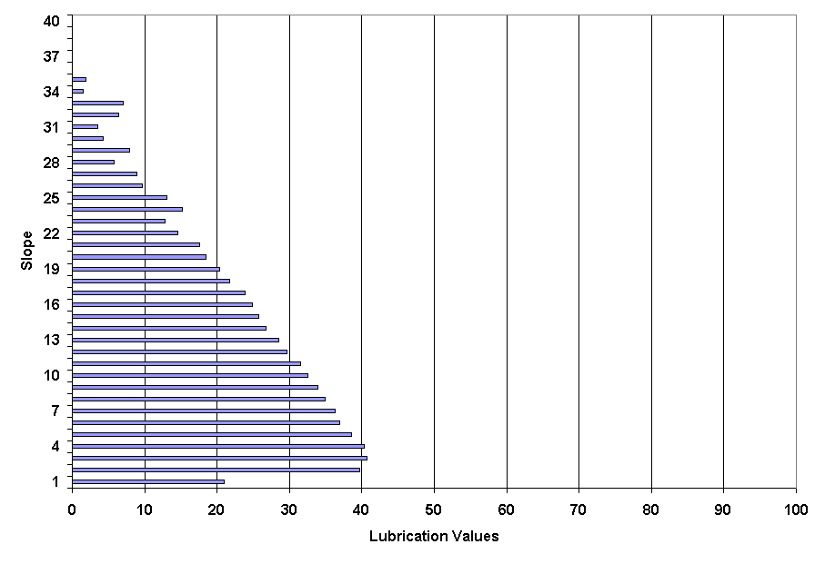
Topographic Slope versus Built
Percent Built
Built map of 1985 for
calibration of spatial pattern.

Slide 82
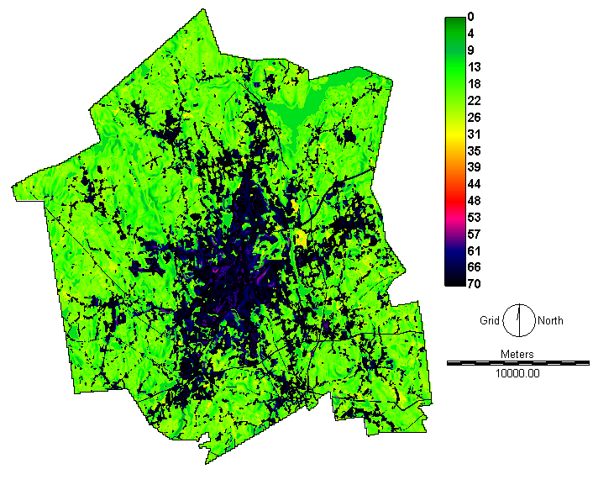
Suitability Map

Slide 83
Simulation begins at 1985

Slide 84
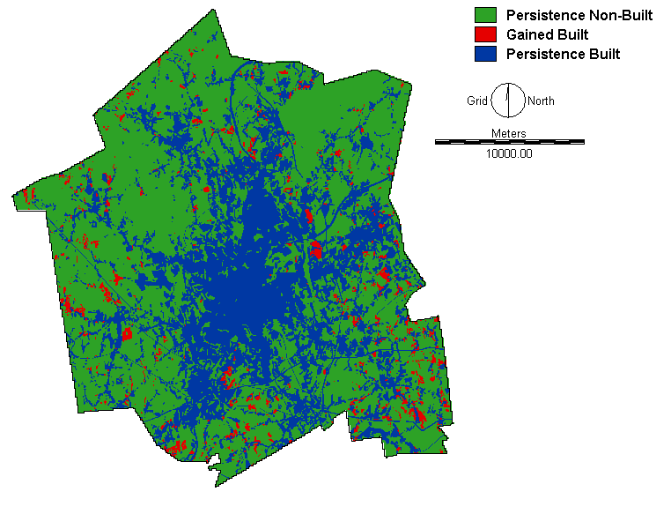
Predicted 1985-1999

Slide 85
Observed 1985-1999

Slide 86
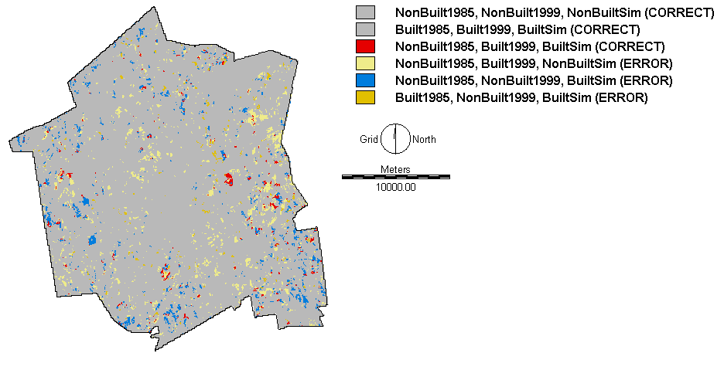
Overlay of:
1985reference, 1999reference, 1999predicted

Slide 87
International Comparison Exercise
We invited land-change modelers to submit:
  Reference Map of Time 1,
  Reference Map of Time 2,
  Prediction Map of Time 2,
  Criterion to evaluate the maps.
Pontius Jr, Robert Gilmore, Wideke Boersma, Jean-Christophe Castella, Keith Clarke, Ton de Nijs, Charles Dietzel, Zengqiang Duan, Eric Fotsing, Noah Goldstein, Kasper Kok, Eric Koomen, Christopher D. Lippitt, William McConnell, Alias Mohd Sood, Bryan Pijanowski, Snehal Pithadia, Sean Sweeney, Tran Ngoc Trung, A. Tom Veldkamp, and Peter H. Verburg. 2008. Comparing the input, output, and validation maps for several models of land change. The Annals of Regional Science 42(1): 11-47.

Slide 88
Contributors’ Twelve Sites
Haidian,China
Honduras
Cho Don, Vietnam
Perinet, Madagascar

Slide 89
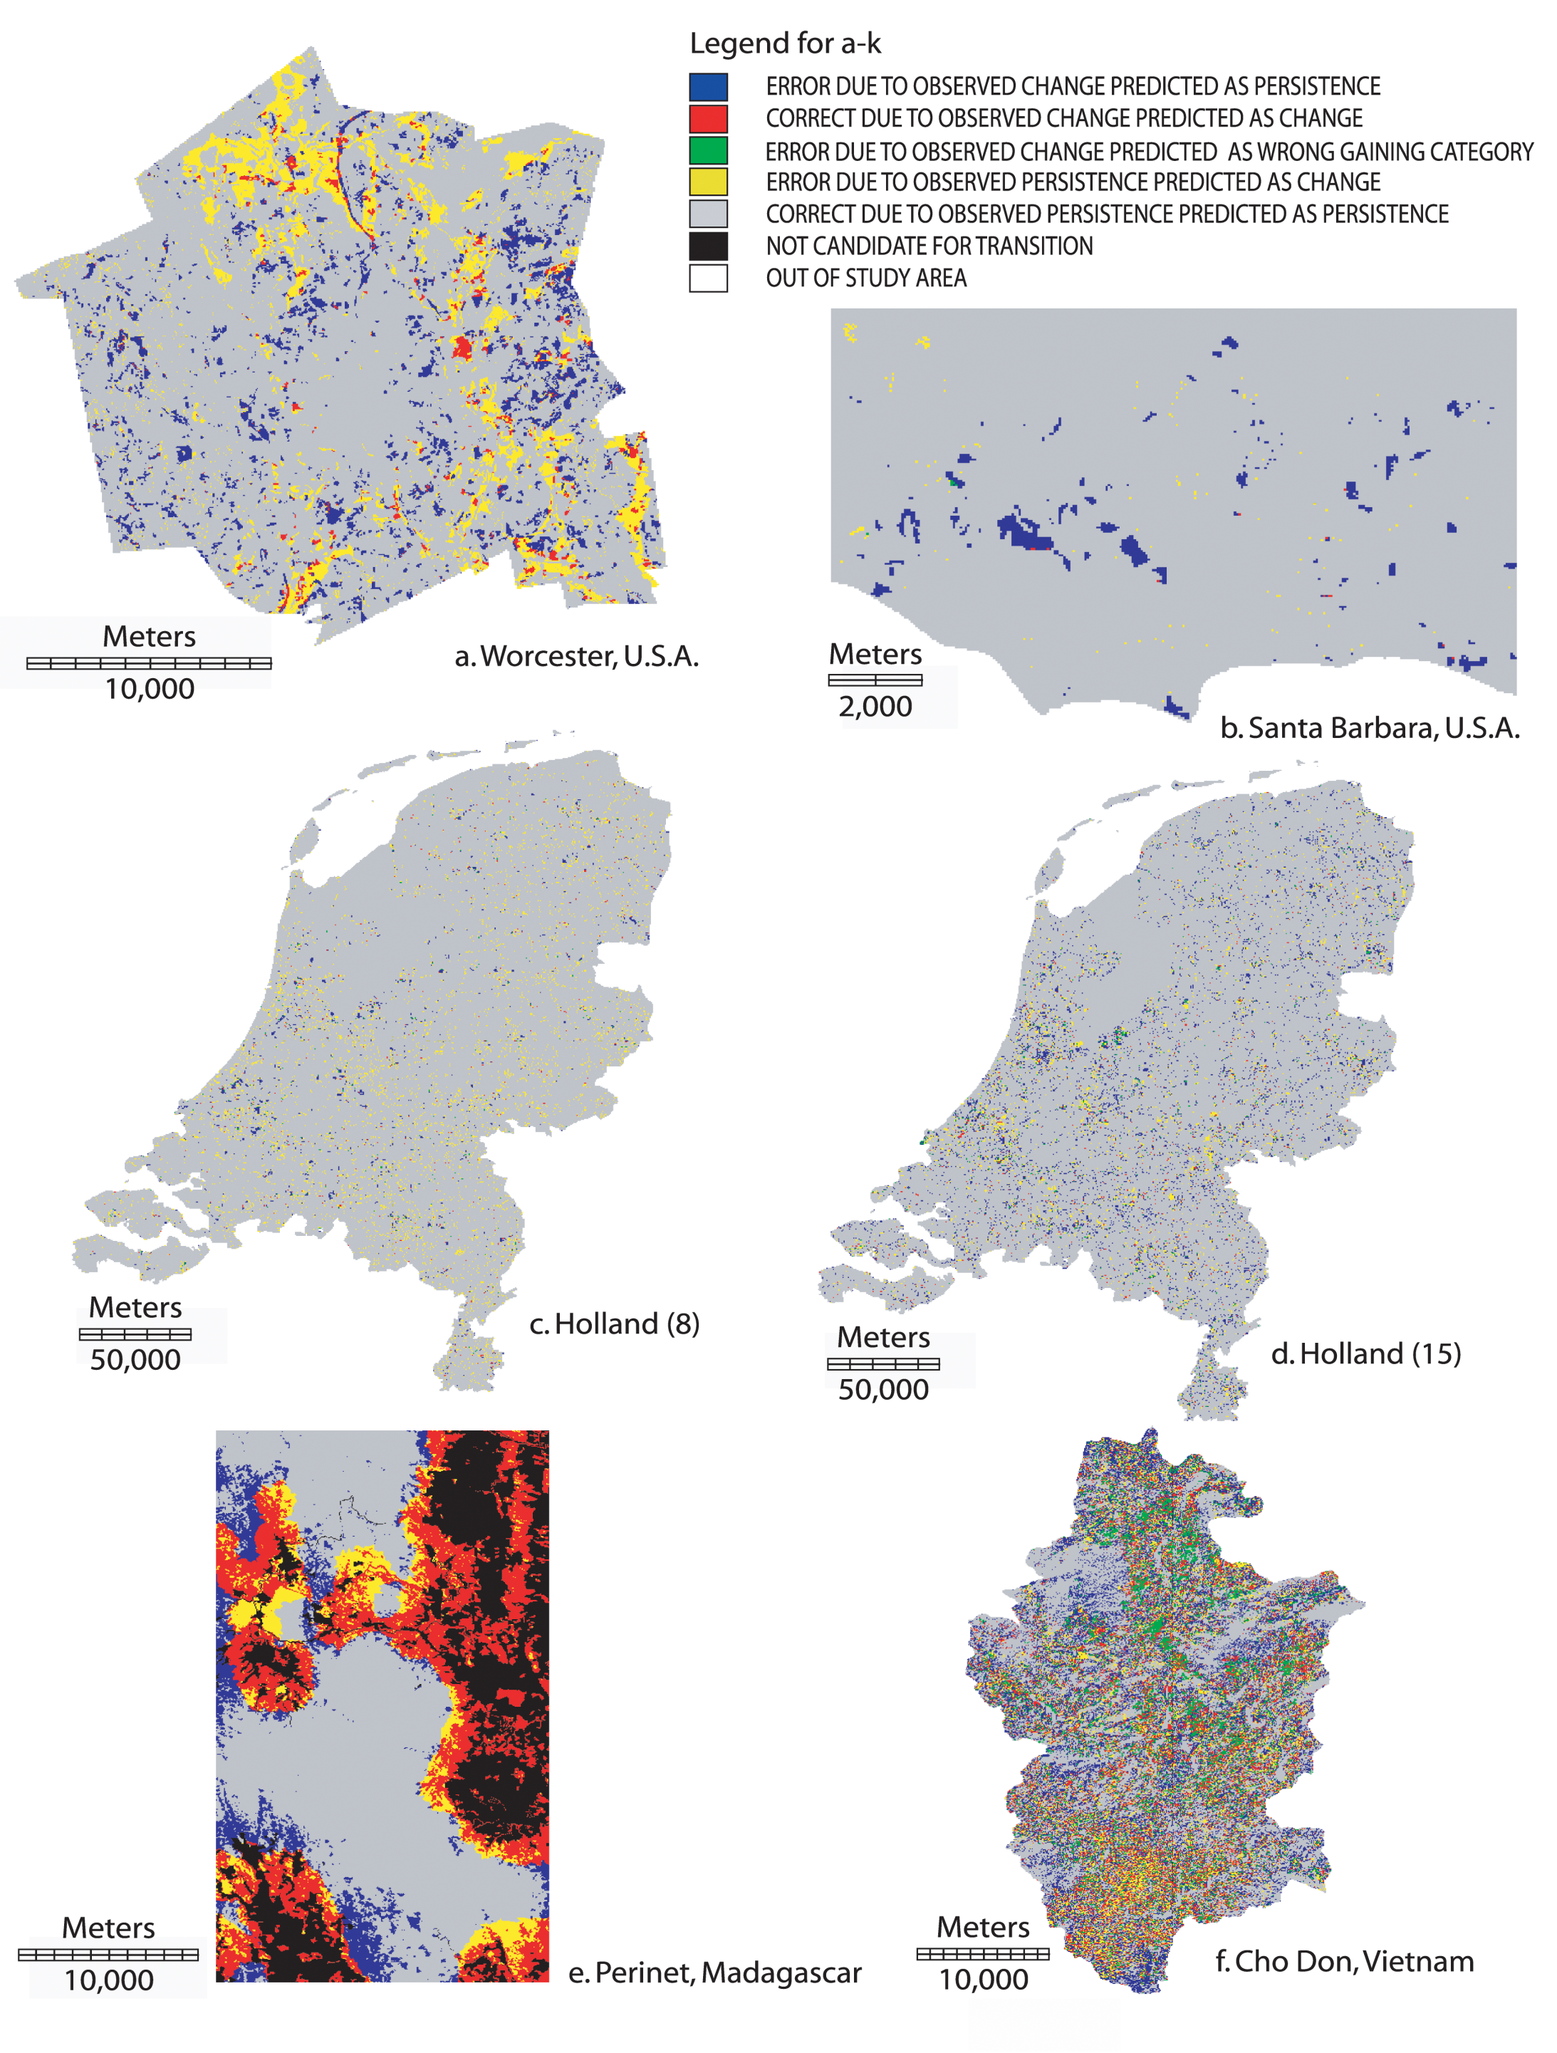

Geomod
There is more error than correctly predicted change.
Most of the error is due to predicting the wrong location by not more than 4 kilometers.
Miss
Hit
Wrong Hit
False Alarm
Correct Rejection

Slide 90

Geomod and SLEUTH
Most of the error is due to predicting too little quantity of change.
Miss
Hit
Wrong Hit
False Alarm
Correct Rejection

Slide 91

Land Use Scanner and Environment Explorer
We need to consider data quality and format, especially when
the amount of change is small.
Miss
Hit
Wrong Hit
False Alarm
Correct Rejection

Slide 92
Logistic Regression and SAMBA
Perinet is the only case that has more correctly predicted change than error.
SAMBA and subsequent models use post-time 1 information for calibration.
Miss
Hit
Wrong Hit
False Alarm
Correct Rejection

Slide 93
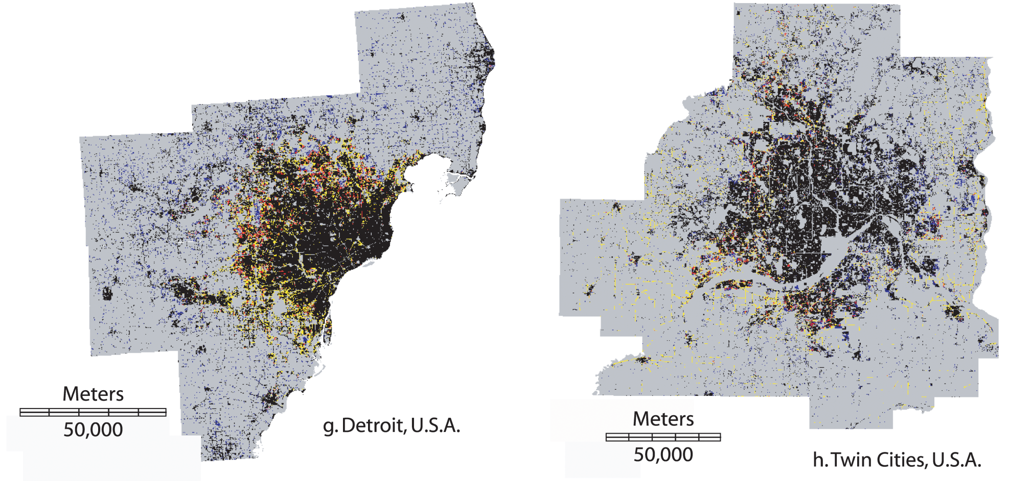
Land Transformation Model
Data and model show one-way change from non-urban to urban.
Simulation uses the correct quantity of urban gain.
Prediction of location is better than random, but not better than null.
Miss
Hit
Wrong Hit
False Alarm
Correct Rejection

Slide 94


CLUE-S
All three use the correct quantities from time 2.
All three are better than random and better than null.

Slide 95

CLUE
It is possible to model and to measure accuracy with heterogenous pixels.

Slide 96


13 cases

Slide 97
Venn Diagrams for 13 cases

Slide 98
Rare events are difficult to predict
Cases with less than 15% figure of merit have less than 10% observed net change.

Slide 99
Observed, Predicted, and Error

Slide 100
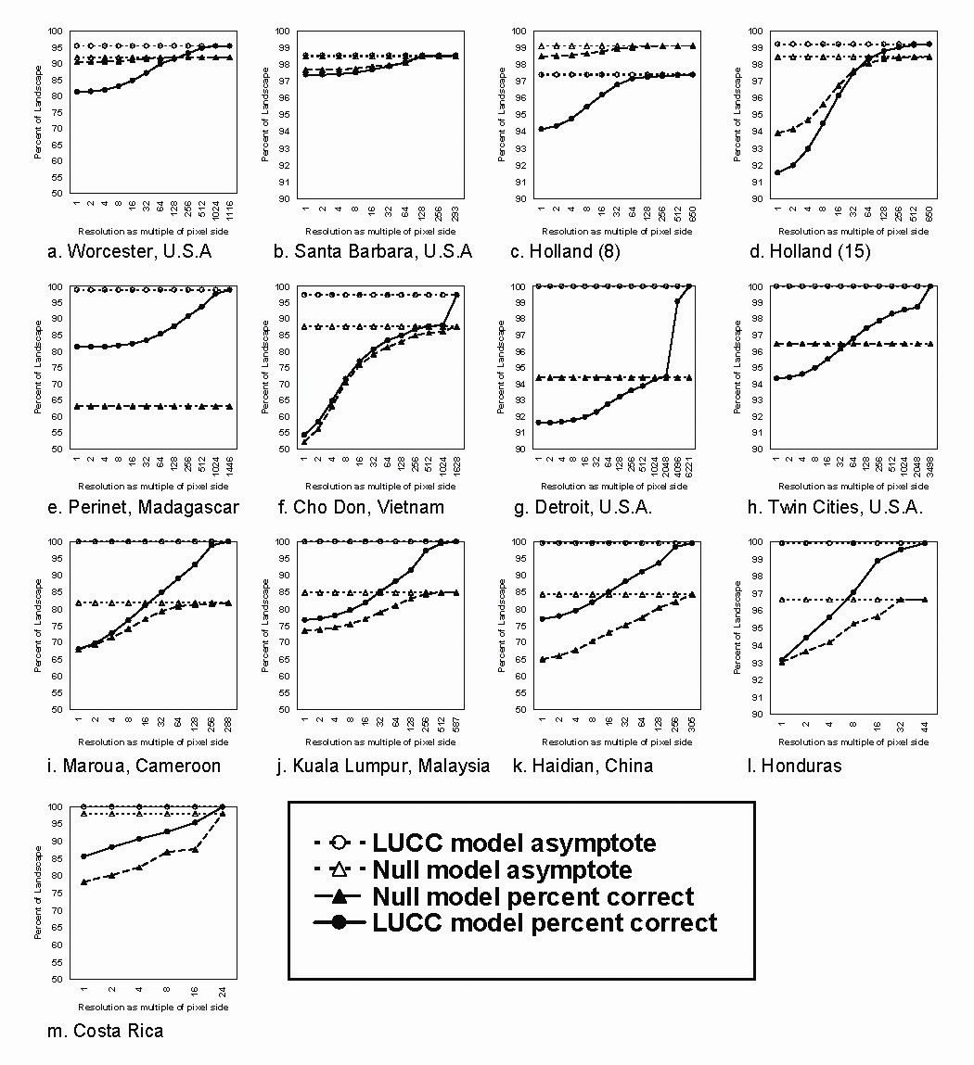
13 Multiple-Resolution Profiles

Slide 101
Characteristics of 13 cases
Site Name | Spatial extent (sq. km.) | Spatial resolution (m) | # of pixels | # of classes | Year1 | Year2 | Year Interval | Uses year 2 quantity | Null resolution (km) | Model
Worcester, U.S.A. | 586 | 30 | 651591 | 2 | 1971 | 1999 | 28 | No | 4 | Geomod
Santa Barbara, U.S.A. | 123 | 50 | 49210 | 7 | 1986 | 1998 | 12 | No | 3 | SLEUTH
Holland(8) | 37280 | 500 | 149119 | 8^{[1]} | 1996 | 2000 | 4 | No | Worse | Land Use Scanner
Holland(15) | 37280 | 500 | 149119 | 15 | 1996 | 2000 | 4 | No | 16 | Environment Explorer
Perinet, Madagascar | 715 | 30 | 794955 | 2^{[2]} | 1957 | 2000 | 43 | No | Better | Logistic Regression
Cho Don, Vietnam | 892 | 32 | 892136 | 6 | 1990 | 2001 | 11 | No | Better | SAMBA
Detroit, U.S.A. | 9175 | 26 | 13209072 | 2† | 1978 | 1998 | 20 | Yes | 27 | LTM
Twin Cities, U.S.A. | 6347 | 30 | 7052459 | 2† | 1991 | 1998 | 7 | Yes | 2 | LTM
Maroua, Cameroon | 3572 | 250 | 57144 | 6 | 1987 | 1999 | 12 | Yes | Better | CLUE-S
Kuala Lumpur, Malaysia | 3810 | 150 | 169333 | 6 | 1990 | 1999 | 9 | Yes | Better | CLUE-S
Haidian, China | 431 | 100 | 43077 | 8 | 1991 | 2001 | 9 | Yes | Better | CLUE-S
Honduras | 96975 | 15000 | 431 | 6^{[3]} | 1974 | 1993 | 19 | Yes | Better | CLUE
Costa Rica | 48600 | 15000 | 216 | 6‡ | 1973 | 1984 | 11 | Yes | Better | CLUE
^{[1]} The original pixels contain partial membership to 36 categories, which are then reassigned the dominant category after the prediction.
^{[2]} The reference maps and the model are designed to show exclusively a one-way transition.
^{[3]} The pixels contain simultaneous partial membership to multiple categories.

Slide 102
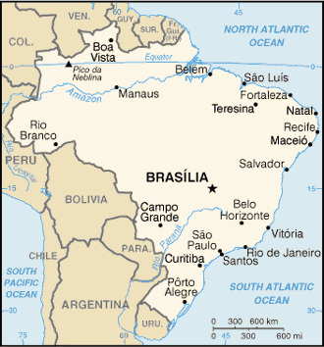
Highway in Pará, Brazil
Pontius Jr, Robert Gilmore, Robert Walker, Robert Yao-Kumah, Eugeino Arima, Stephen Aldrich, Marcellus Caldas and Dante Vergara. 2007. Accuracy assessment for a simulation model of Amazonian deforestation. Annals of the Association of American Geographers 97(4): 677-695.

Slide 103
Regional Strata

Slide 104
Household Sub-Strata

Slide 105
Reference with 26% deforestation in 1999

Slide 106
Simulation with 15% deforestation
target intercept = 40
frontier speed = 0.8
maximum duration = 6

Slide 107
Simulation with 24% deforestation
target intercept = 60
frontier speed = 0.8
maximum duration = 3

Slide 108
Simulation with 49% deforestation
target intercept = 80
frontier speed = 1.6
maximum duration = 3

Slide 109
Prediction with 15% deforestation
target intercept = 40
frontier speed = 0.8
maximum duration = 6

Slide 110
Prediction with 24% deforestation
target intercept = 60
frontier speed = 0.8
maximum duration = 3

Slide 111
Prediction with 49% deforestation
target intercept = 80
frontier speed = 1.6
maximum duration = 3

Slide 112
BLM versus Highway Model

Slide 113
Multiple Resolution Assessment

Slide 114

Starry Night by Vincent van Gogh

